Slide 1
Chapter II – Statistical modeling and estimation

Slide 2
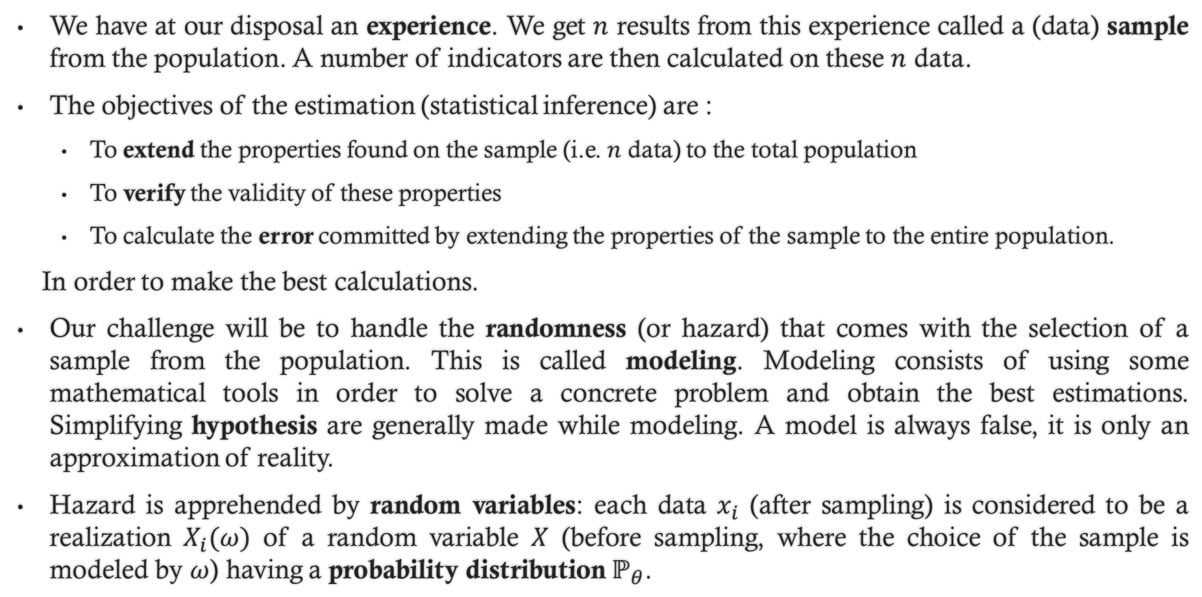
1. Introduction to estimation
We have at our disposal an experience. We get $n$ results from this experience called a (data) sample from the population. A number of indicators are then calculated on these $n$ data.
The objectives of the estimation (statistical inference) are :
To extend the properties found on the sample (i.e. $n$ data) to the total population
To verify the validity of these properties
To calculate the error committed by extending the properties of the sample to the entire population.
In order to make the best calculations.
Our challenge will be to handle the randomness (or hazard) that comes with the selection of a sample from the population. This is called modeling. Modeling consists of using some mathematical tools in order to solve a concrete problem and obtain the best estimations. Simplifying hypothesis are generally made while modeling. A model is always false, it is only an approximation of reality.
Hazard is apprehended by random variables: each data $x_{i}$ (after sampling) is considered to be a realization $X_{i}(ω)$ of a random variable $X$ (before sampling, where the choice of the sample is modeled by $ω$) having a probability distribution $ℙ_{θ}$.

Slide 3
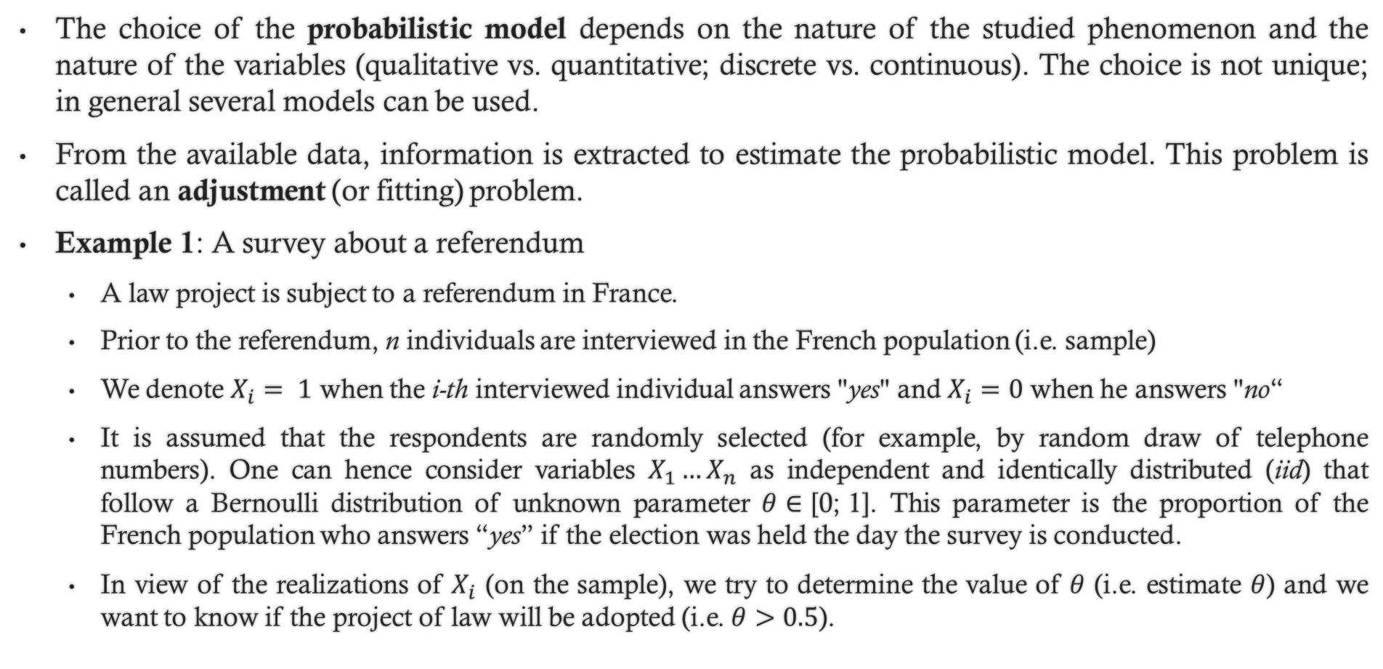
1. Introduction to estimation
The choice of the probabilistic model depends on the nature of the studied phenomenon and the nature of the variables (qualitative vs. quantitative; discrete vs. continuous). The choice is not unique; in general several models can be used.
From the available data, information is extracted to estimate the probabilistic model. This problem is called an adjustment (or fitting) problem.
Example 1: A survey about a referendum
A law project is subject to a referendum in France.
Prior to the referendum, n individuals are interviewed in the French population (i.e. sample)
We denote $X_{i}= 1$ when the i-th interviewed individual answers "yes" and $X_{i}=0$ when he answers "no“
It is assumed that the respondents are randomly selected (for example, by random draw of telephone numbers). One can hence consider variables $X_{1}…X_{n}$ as independent and identically distributed (iid) that follow a Bernoulli distribution of unknown parameter $θ∈\text{[0; 1]}$. This parameter is the proportion of the French population who answers “yes” if the election was held the day the survey is conducted.
In view of the realizations of $X_{i}$ (on the sample), we try to determine the value of $θ$ (i.e. estimate $θ$) and we want to know if the project of law will be adopted (i.e. $θ>0.5$).

Slide 4
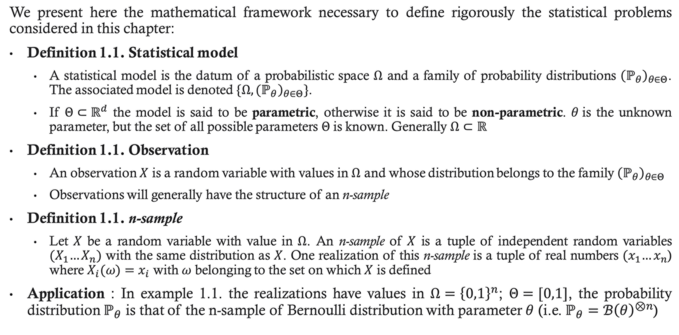
2. Statistical modeling terminology
We present here the mathematical framework necessary to define rigorously the statistical problems considered in this chapter:
Definition 1.1. Statistical model
A statistical model is the datum of a probabilistic space $Ω$ and a family of probability distributions ${\left(ℙ_{θ}\right)}_{θ∈Θ}$. The associated model is denoted ${\{\left.Ω, {(ℙ}_{θ}\right)}_{θ∈Θ}\}$.
If $Θ⊂ℝ^{d}$ the model is said to be parametric, otherwise it is said to be non-parametric. $θ$is the unknown parameter, but the set of all possible parameters $Θ$is known. Generally $Ω⊂ℝ$
Definition 1.1. Observation
An observation $X$ is a random variable with values in $Ω$ and whose distribution belongs to the family${\left(ℙ_{θ}\right)}_{θ∈Θ}$
Observations will generally have the structure of an n-sample
Definition 1.1. n-sample
Let $X$ be a random variable with value in $Ω$. An n-sample of $X$ is a tuple of independent random variables ${(X}_{1}…X_{n})$ with the same distribution as $X$. One realization of this n-sample is a tuple of real numbers ${(x}_{1}…x_{n}$) where $X_{i}(ω)=x_{i}$ with $ω$ belonging to the set on which $X$ is defined
Application : In example 1.1. the realizations have values in $Ω={\left\{0,1\right\}}^{n}$; $Θ=[0,1]$, the probability distribution $ℙ_{θ}$ is that of the n-sample of Bernoulli distribution with parameter $θ$ (i.e. $ℙ_{θ}=ℬ{\left(θ\right)}^{⊗n}$)

Slide 5
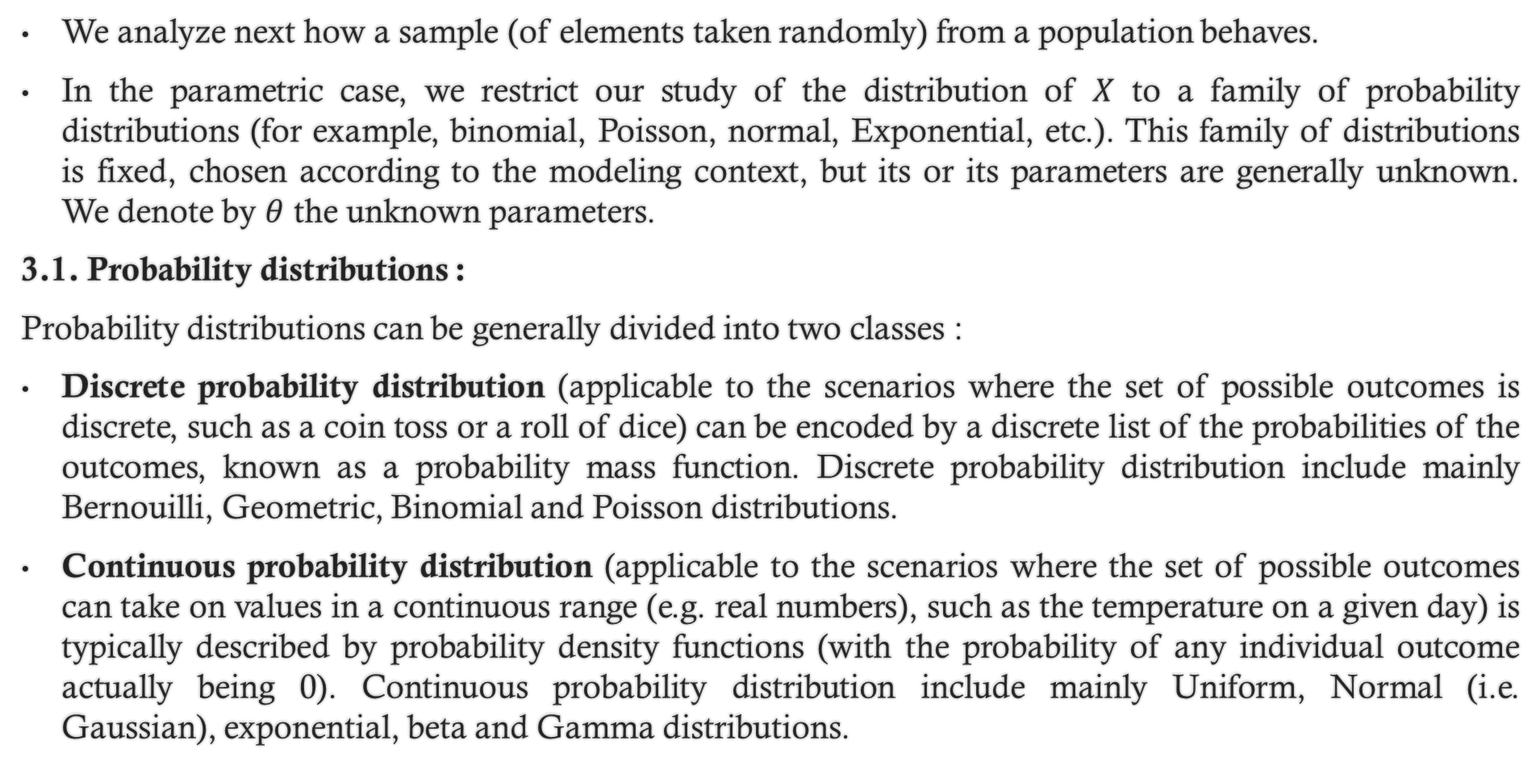
3. Estimation
We analyze next how a sample (of elements taken randomly) from a population behaves.
In the parametric case, we restrict our study of the distribution of $X$ to a family of probability distributions (for example, binomial, Poisson, normal, Exponential, etc.). This family of distributions is fixed, chosen according to the modeling context, but its or its parameters are generally unknown. We denote by $θ$ the unknown parameters.
3.1. Probability distributions :
Probability distributions can be generally divided into two classes :
Discrete probability distribution (applicable to the scenarios where the set of possible outcomes is discrete, such as a coin toss or a roll of dice) can be encoded by a discrete list of the probabilities of the outcomes, known as a probability mass function. Discrete probability distribution include mainly Bernouilli, Geometric, Binomial and Poisson distributions.
Continuous probability distribution (applicable to the scenarios where the set of possible outcomes can take on values in a continuous range (e.g. real numbers), such as the temperature on a given day) is typically described by probability density functions (with the probability of any individual outcome actually being 0). Continuous probability distribution include mainly Uniform, Normal (i.e. Gaussian), exponential, beta and Gamma distributions.

Slide 6
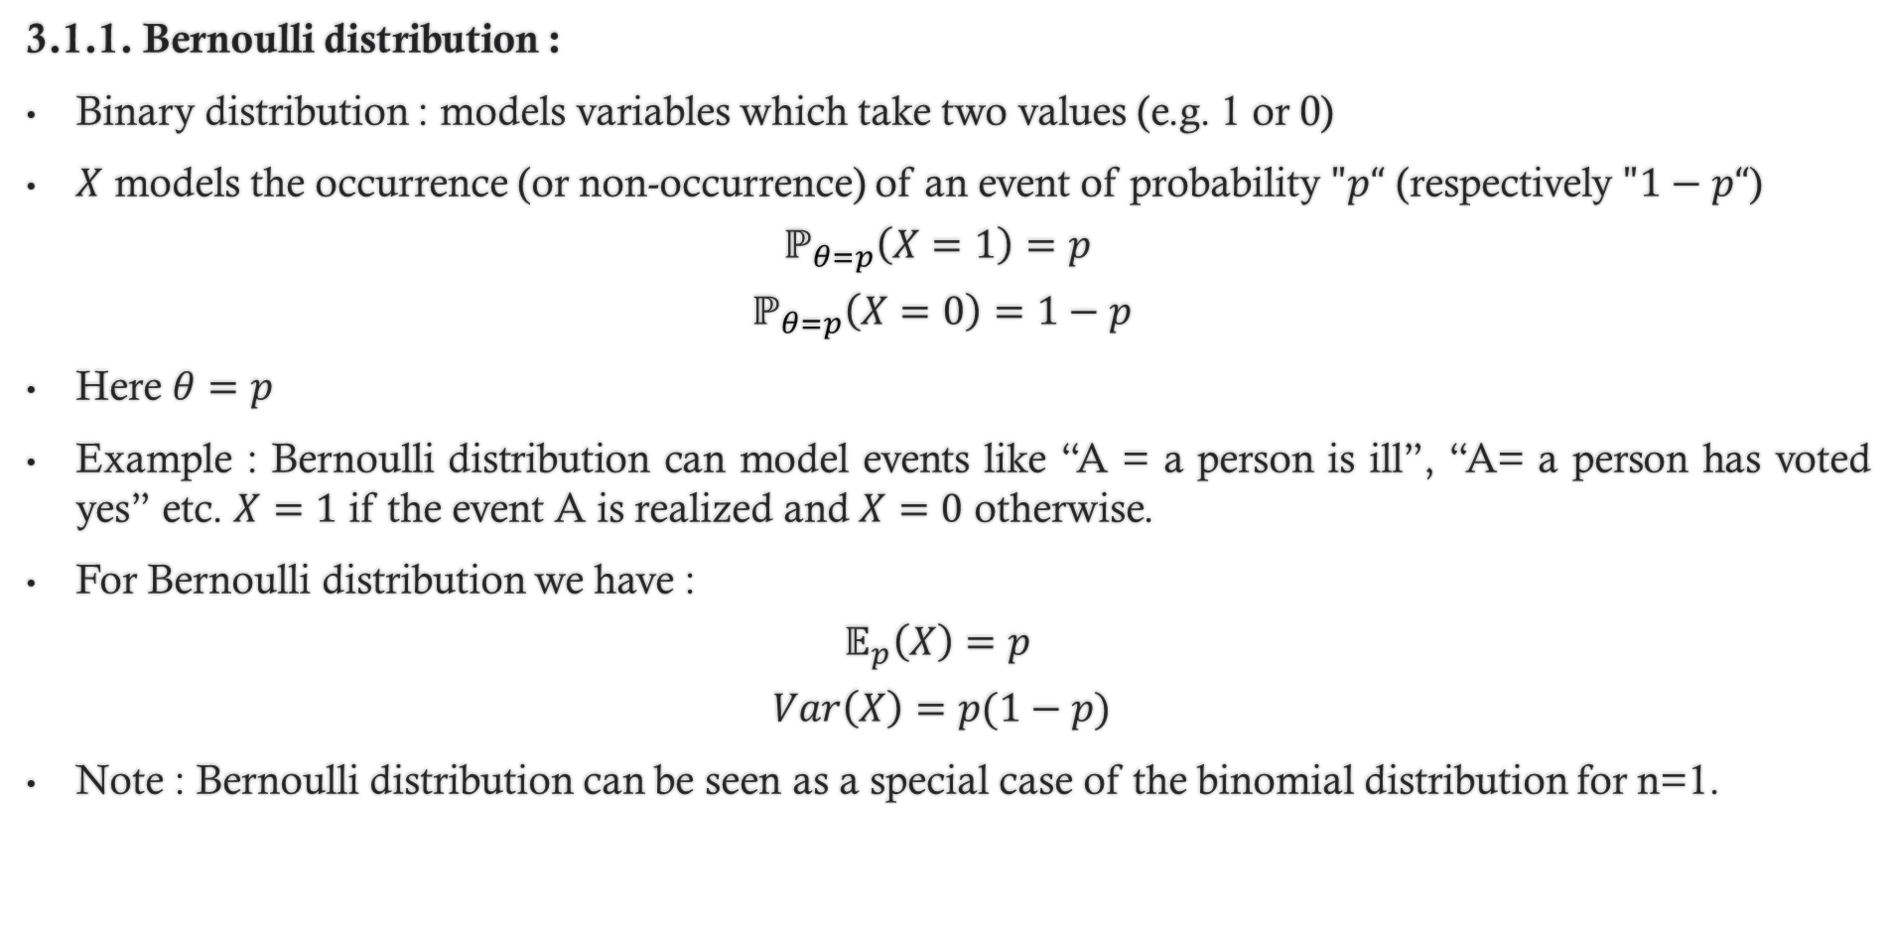
3. Estimation
3.1.1. Bernoulli distribution :
Binary distribution : models variables which take two values (e.g. 1 or 0)
$X$ models the occurrence (or non-occurrence) of an event of probability $"p“$ (respectively $"1−p“$)
$$ℙ_{θ=p}\left(X=1\right)=p$$
$$ℙ_{θ=p}\left(X=0\right)=1−p$$
Here $θ=p$
Example : Bernoulli distribution can model events like “A = a person is ill”, “A= a person has voted yes” etc. $X=1$ if the event A is realized and $X=0$ otherwise.
For Bernoulli distribution we have :
$$𝔼_{p}\left(X\right)=p$$
$$Var\left(X\right)=p(1−p)$$
Note : Bernoulli distribution can be seen as a special case of the binomial distribution for n=1.

Slide 7
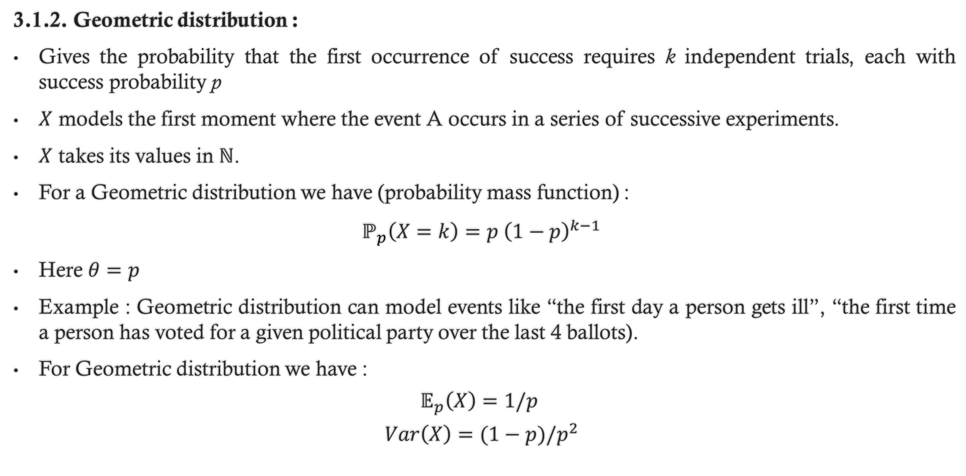
3. Estimation
3.1.2. Geometric distribution :
Gives the probability that the first occurrence of success requires k independent trials, each with success probability p
$X$ models the first moment where the event A occurs in a series of successive experiments.
$X$ takes its values in $ℕ$.
For a Geometric distribution we have (probability mass function) :
$$ℙ_{p}\left(X=k\right)=p {\left(1−p\right)}^{k−1}$$
Here $θ=p$
Example : Geometric distribution can model events like “the first day a person gets ill”, “the first time a person has voted for a given political party over the last 4 ballots).
For Geometric distribution we have :
$$𝔼_{p}\left(X\right)=1/p$$
$$Var\left(X\right)=(1−p)/p^{2}$$

Slide 8
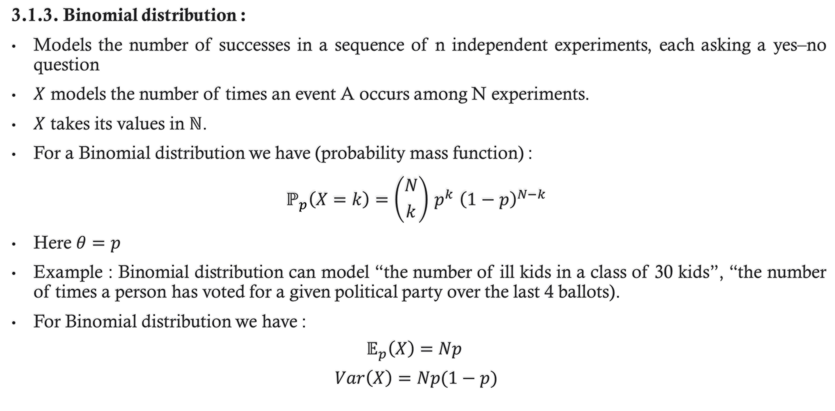
3. Estimation
3.1.3. Binomial distribution :
Models the number of successes in a sequence of n independent experiments, each asking a yes–no question
$X$ models the number of times an event A occurs among N experiments.
$X$ takes its values in $ℕ$.
For a Binomial distribution we have (probability mass function) :
$$ℙ_{p}\left(X=k\right)=\left({N \atop k}\right){ p}^{k} {\left(1−p\right)}^{N−k}$$
Here $θ=p$
Example : Binomial distribution can model “the number of ill kids in a class of 30 kids”, “the number of times a person has voted for a given political party over the last 4 ballots).
For Binomial distribution we have :
$$𝔼_{p}\left(X\right)=Np$$
$$Var\left(X\right)=Np(1−p)$$

Slide 9
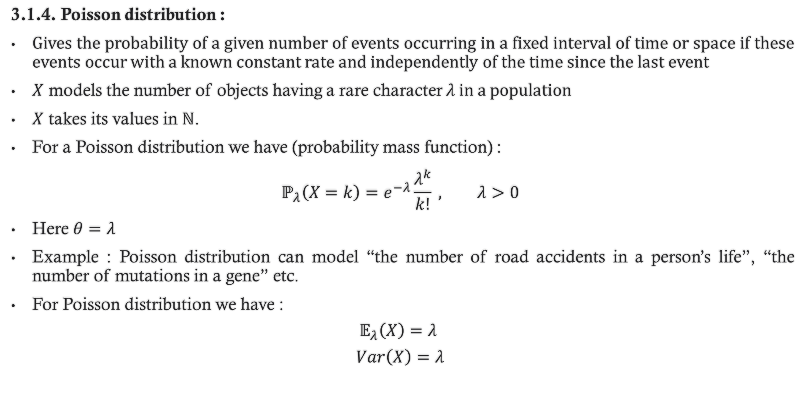
3. Estimation
3.1.4. Poisson distribution :
Gives the probability of a given number of events occurring in a fixed interval of time or space if these events occur with a known constant rate and independently of the time since the last event
$X$ models the number of objects having a rare character $λ$ in a population
$X$ takes its values in $ℕ$.
For a Poisson distribution we have (probability mass function) :
$$ℙ_{λ}\left(X=k\right)=e^{−λ}\frac{λ^{k}}{k!} , λ>0$$
Here $θ=λ$
Example : Poisson distribution can model “the number of road accidents in a person’s life”, “the number of mutations in a gene” etc.
For Poisson distribution we have :
$$𝔼_{λ}\left(X\right)=λ$$
$$Var\left(X\right)=λ$$

Slide 10
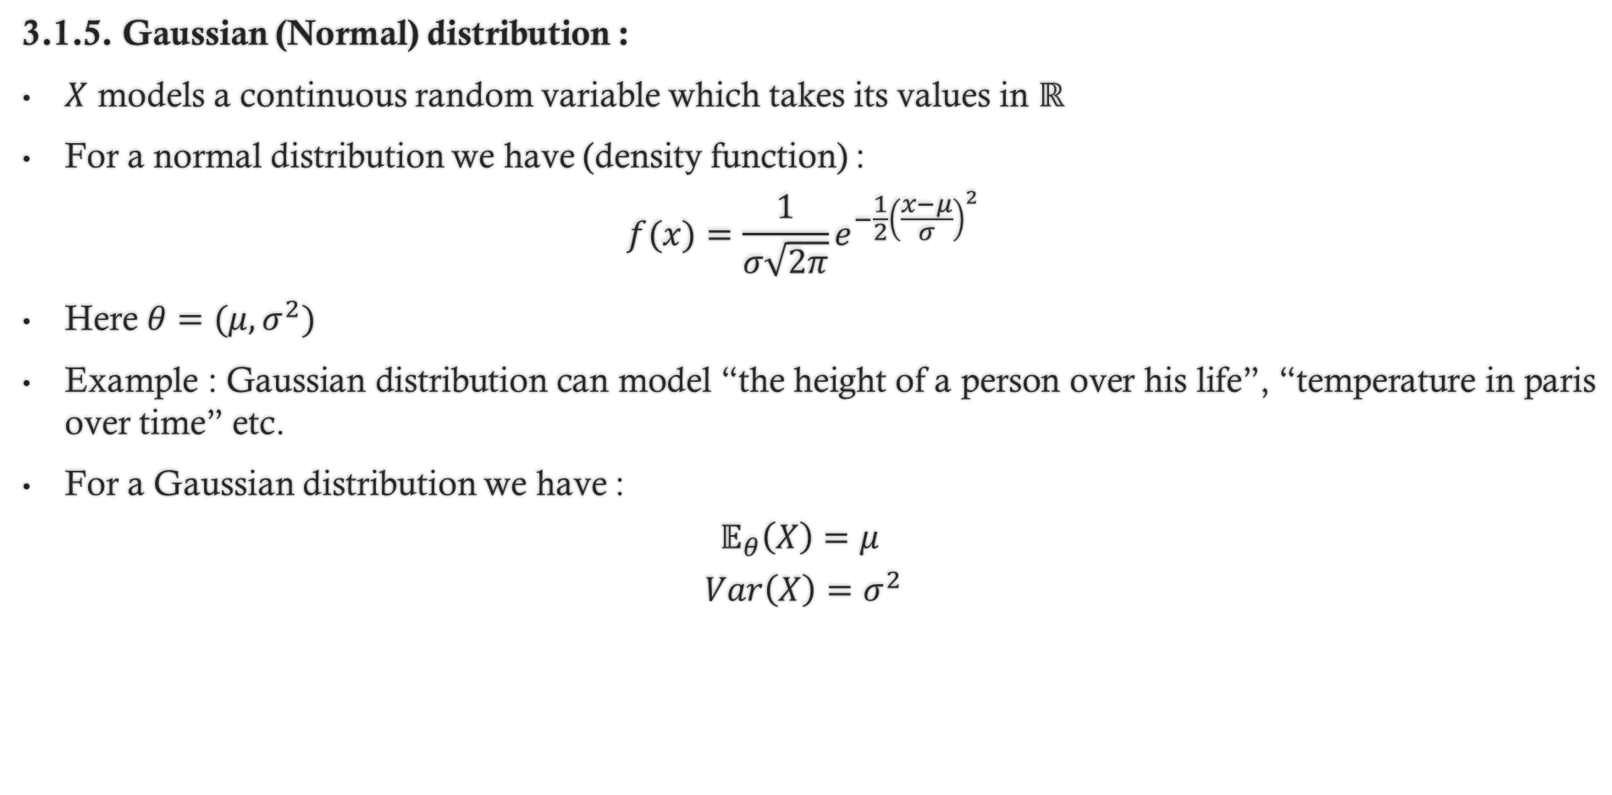
3. Estimation
3.1.5. Gaussian (Normal) distribution :
$X$ models a continuous random variable which takes its values in $ℝ$
For a normal distribution we have (density function) :
$$f(x)=\frac{1}{σ\sqrt{2π}}e^{−\frac{1}{2}{\left(\frac{x−μ}{σ}\right)}^{2}}$$
Here $θ=(μ,σ^{2})$
Example : Gaussian distribution can model “the height of a person over his life”, “temperature in paris over time” etc.
For a Gaussian distribution we have :
$$𝔼_{θ}\left(X\right)=μ$$
$$Var\left(X\right)=σ^{2}$$

Slide 11
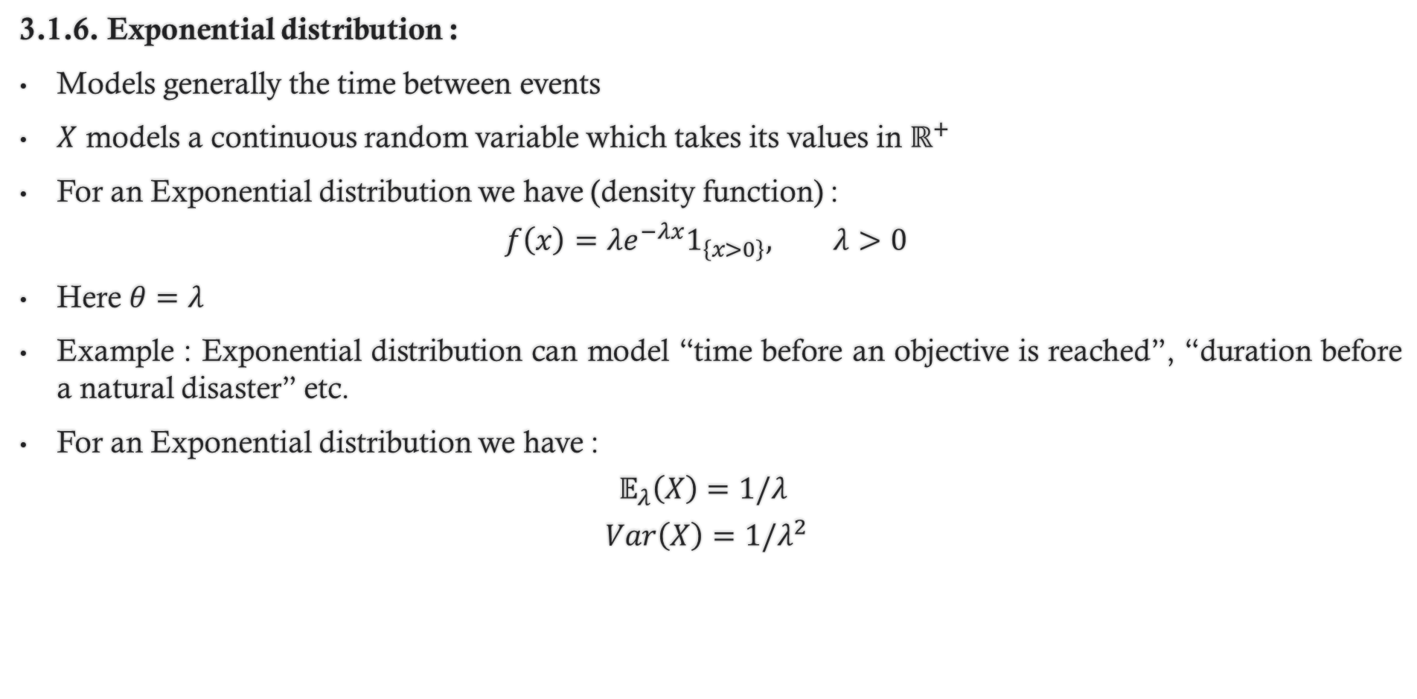
3. Estimation
3.1.6. Exponential distribution :
Models generally the time between events
$X$ models a continuous random variable which takes its values in $ℝ^{+}$
For an Exponential distribution we have (density function) :
$$f\left(x\right)=λe^{−λx}1_{\left\{x>0\right\}}, λ>0$$
Here $θ=λ$
Example : Exponential distribution can model “time before an objective is reached”, “duration before a natural disaster” etc.
For an Exponential distribution we have :
$$𝔼_{λ}\left(X\right)=1/λ$$
$$Var\left(X\right)=1/λ^{2}$$

Slide 12
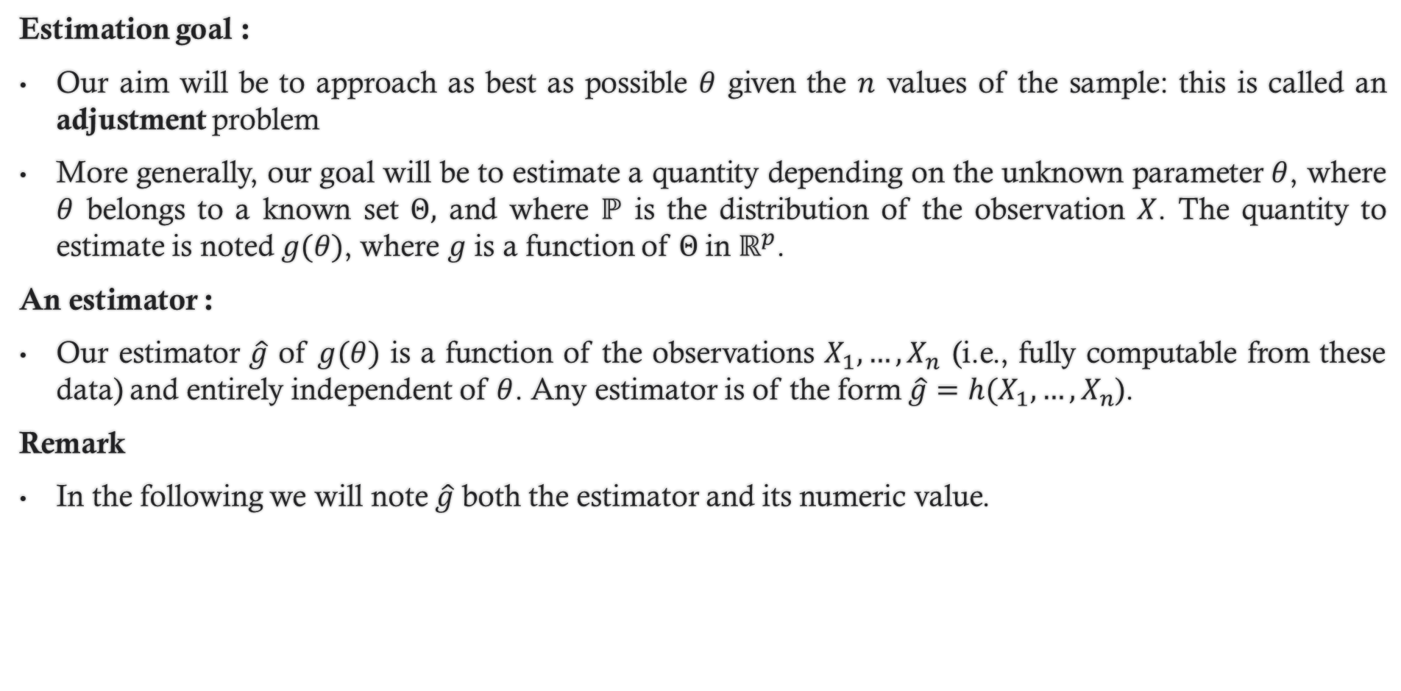
3. Estimation
Estimation goal :
Our aim will be to approach as best as possible $θ$ given the $n$ values of the sample: this is called an adjustment problem
More generally, our goal will be to estimate a quantity depending on the unknown parameter $θ$, where $θ$ belongs to a known set $Θ,$ and where $ℙ$ is the distribution of the observation $X$. The quantity to estimate is noted $g(θ)$, where $g$ is a function of $Θ$in $ℝ^{p}$.
An estimator :
Our estimator $\hat{g}$ of $g(θ)$ is a function of the observations $X_{1},…, X_{n}$ (i.e., fully computable from these data) and entirely independent of $θ$. Any estimator is of the form $\hat{g}=h(X_{1},…,X_{n}$).
Remark
In the following we will note $\hat{g}$ both the estimator and its numeric value.

Slide 13
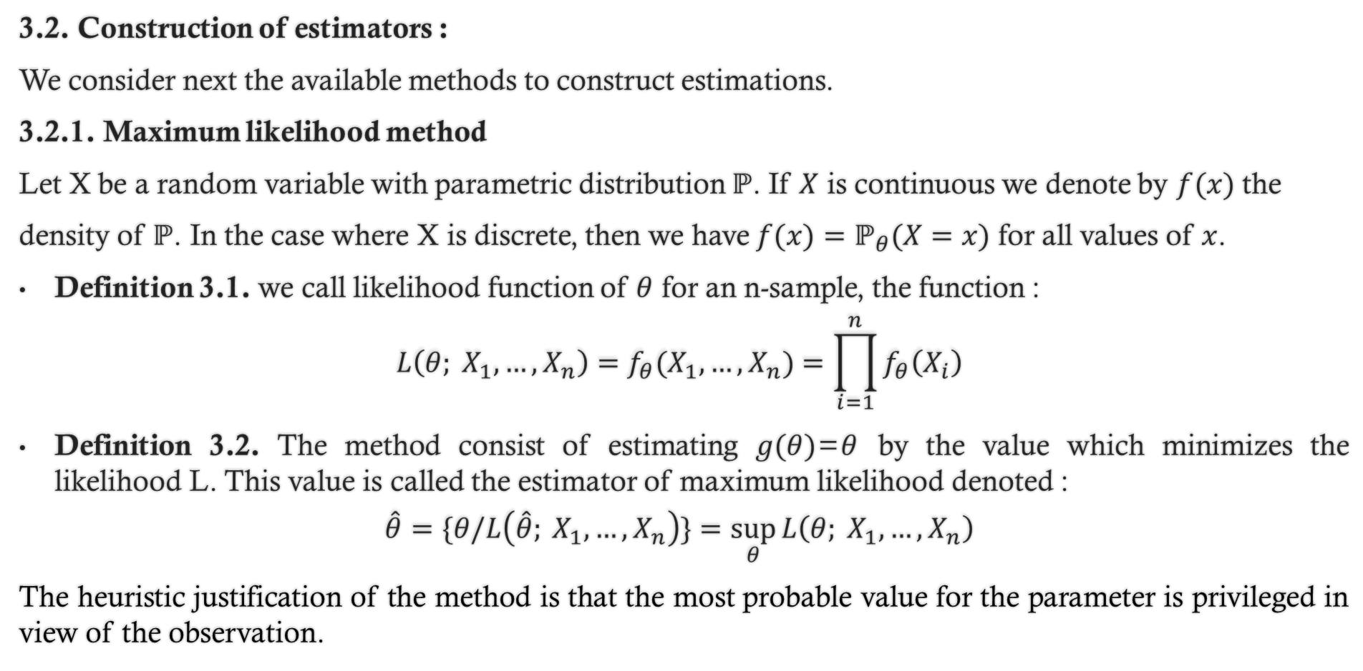
3. Estimation
3.2. Construction of estimators :
We consider next the available methods to construct estimations.
3.2.1. Maximum likelihood method
Let X be a random variable with parametric distribution $ℙ$. If $X$ is continuous we denote by $f(x)$ the
density of $ℙ$. In the case where X is discrete, then we have $f(x)=ℙ_{θ}(X=x)$ for all values of $x$.
Definition 3.1. we call likelihood function of $θ$ for an n-sample, the function :
$$L\left(θ; X_{1},…,X_{n}\right)=f_{θ}(X_{1},…,X_{n})=\prod_{i=1}^{n}{f_{θ}\left(X_{i}\right)}$$
Definition 3.2. The method consist of estimating $g(θ)$=$θ$ by the value which minimizes the likelihood L. This value is called the estimator of maximum likelihood denoted :
$$\hat{θ}=\{θ/L\left(\hat{θ}; X_{1},…,X_{n}\right)\}=\sup_{θ}{L\left(θ; X_{1},…,X_{n}\right)}$$
The heuristic justification of the method is that the most probable value for the parameter is privileged in view of the observation.

Slide 14
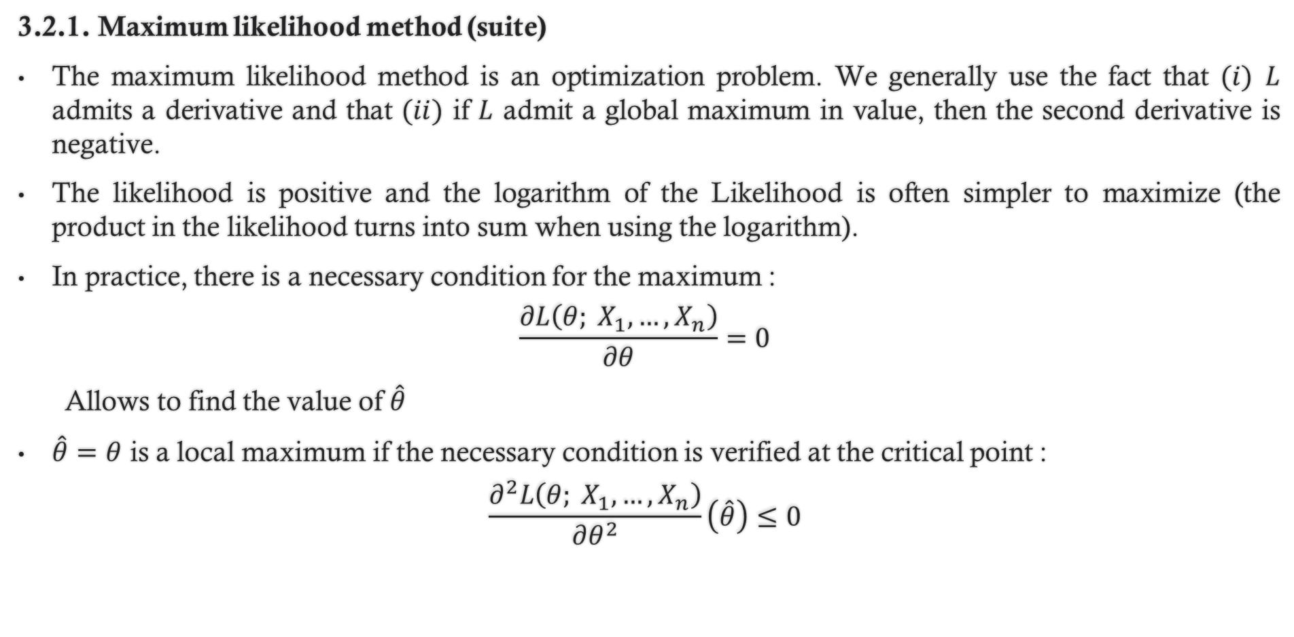
3. Estimation
3.2.1. Maximum likelihood method (suite)
The maximum likelihood method is an optimization problem. We generally use the fact that $(i)$ $L$ admits a derivative and that $(ii)$ if $L$ admit a global maximum in value, then the second derivative is negative.
The likelihood is positive and the logarithm of the Likelihood is often simpler to maximize (the product in the likelihood turns into sum when using the logarithm).
In practice, there is a necessary condition for the maximum :
$$\frac{∂L\left(θ; X_{1},…,X_{n}\right)}{∂θ}=0$$
Allows to find the value of $\hat{θ}$
$\hat{θ}=θ$ is a local maximum if the necessary condition is verified at the critical point :
$$\frac{∂^{2}L\left(θ; X_{1},…,X_{n}\right)}{∂θ^{2}}\left(\hat{θ}\right)≤0$$

Slide 15
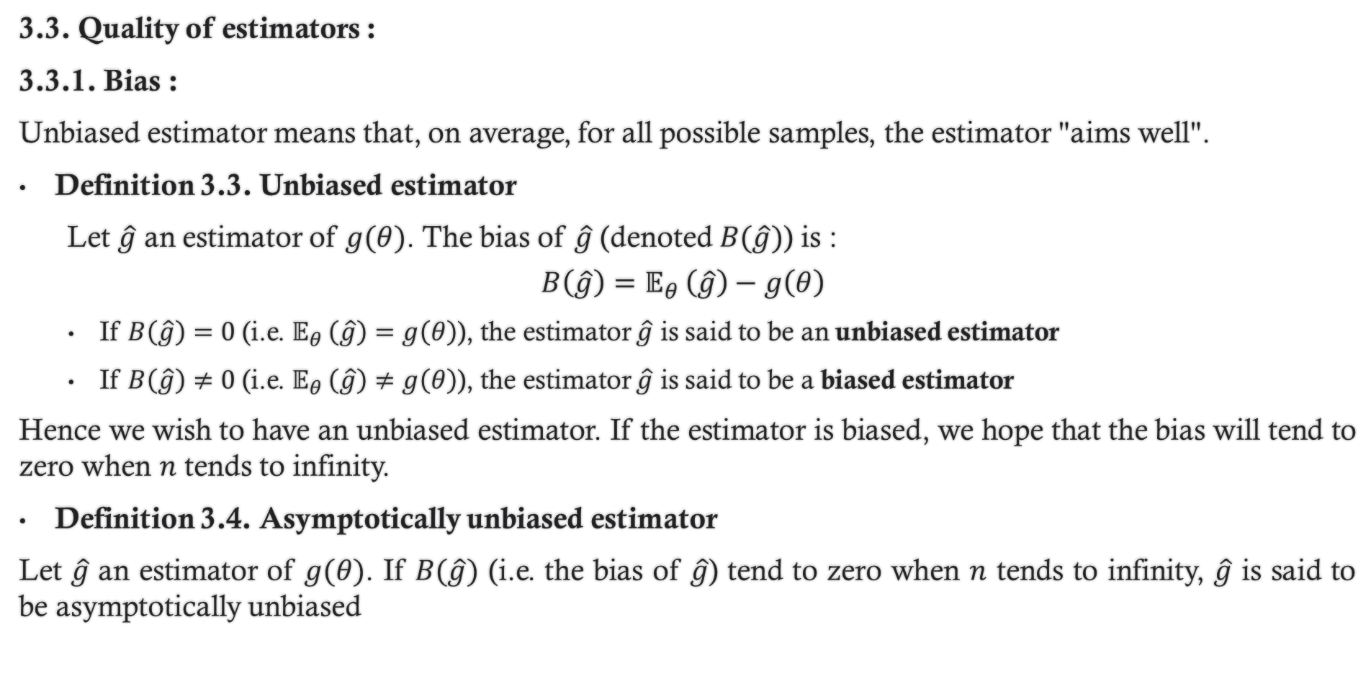
3. Estimation
3.3. Quality of estimators :
3.3.1. Bias :
Unbiased estimator means that, on average, for all possible samples, the estimator "aims well".
Definition 3.3. Unbiased estimator
Let $\hat{g}$ an estimator of $g(θ)$. The bias of $\hat{g}$ (denoted $B(\hat{g})$) is :
$$B\left(\hat{g}\right)=𝔼_{θ }\left(\hat{g}\right)−g\left(θ\right)$$
If $B\left(\hat{g}\right)=0$ (i.e. $𝔼_{θ }\left(\hat{g}\right)=g\left(θ\right)$), the estimator $\hat{g}$ is said to be an unbiased estimator
If $B\left(\hat{g}\right)≠0$ (i.e. $𝔼_{θ }\left(\hat{g}\right)≠g\left(θ\right)$), the estimator $\hat{g}$ is said to be a biased estimator
Hence we wish to have an unbiased estimator. If the estimator is biased, we hope that the bias will tend to zero when $n$ tends to infinity.
Definition 3.4. Asymptotically unbiased estimator
Let $\hat{g}$ an estimator of $g(θ)$. If $B(\hat{g})$ (i.e. the bias of $\hat{g}$) tend to zero when $n$ tends to infinity, $\hat{g}$ is said to be asymptotically unbiased

Slide 16
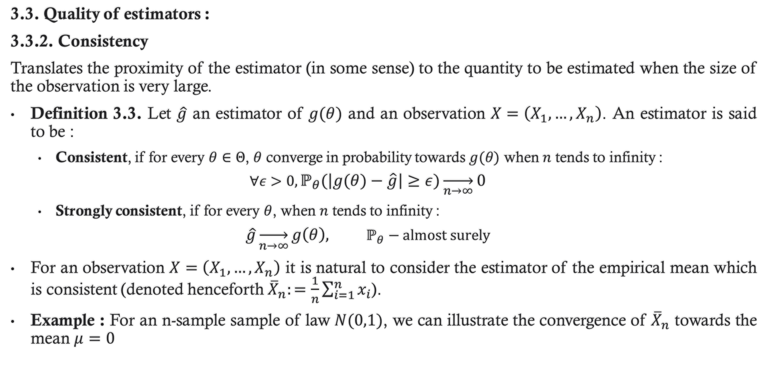
3. Estimation
3.3. Quality of estimators :
3.3.2. Consistency
Translates the proximity of the estimator (in some sense) to the quantity to be estimated when the size of the observation is very large.
Definition 3.3. Let $\hat{g}$ an estimator of $g(θ)$ and an observation $X=\left(X_{1},…,X_{n}\right)$. An estimator is said to be :
Consistent, if for every $θ∈Θ$, $θ$ converge in probability towards $g(θ)$ when $n$ tends to infinity :
$$∀ε>0,ℙ_{θ}\left(\left|g\left(θ\right)−\hat{g}\right|≥ε\right)\overset{→}{n→∞}0$$
Strongly consistent, if for every $θ$, when $n$ tends to infinity :
$$\hat{g}\overset{→}{n→∞}g\left(θ\right), ℙ_{θ}−almost surely$$
For an observation $X=\left(X_{1},…,X_{n}\right)$ it is natural to consider the estimator of the empirical mean which is consistent (denoted henceforth ${\overline{X}}_{n}:=\frac{1}{n}\sum_{i=1}^{n}{x_{i}}$).
Example : For an n-sample sample of law $N(0,1)$, we can illustrate the convergence of ${\overline{X}}_{n}$ towards the mean $μ=0$

Slide 17
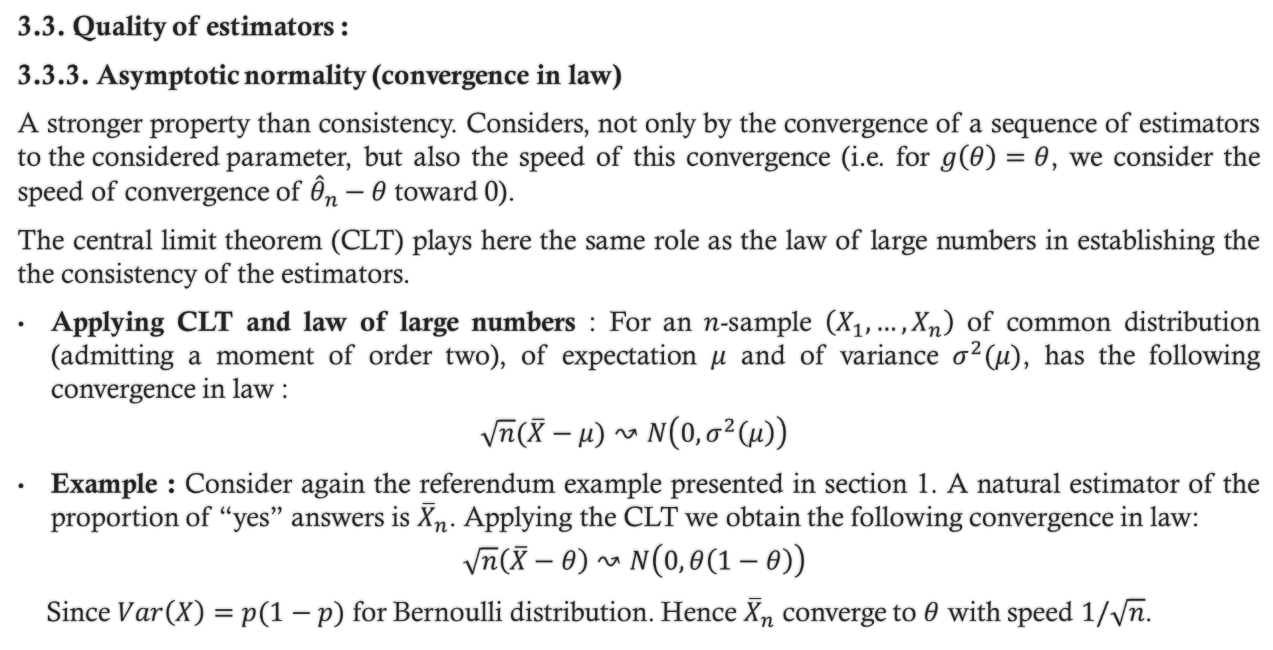
3. Estimation
3.3. Quality of estimators :
3.3.3. Asymptotic normality (convergence in law)
A stronger property than consistency. Considers, not only by the convergence of a sequence of estimators to the considered parameter, but also the speed of this convergence (i.e. for $g\left(θ\right)=θ$, we consider the speed of convergence of ${\hat{θ}}_{n}−θ$ toward 0).
The central limit theorem (CLT) plays here the same role as the law of large numbers in establishing the the consistency of the estimators.
Applying CLT and law of large numbers : For an $n$-sample $\left(X_{1},…,X_{n}\right)$ of common distribution (admitting a moment of order two), of expectation $μ$ and of variance $σ^{2}(μ)$, has the following convergence in law :
$$\sqrt{n}(\overline{X}−μ)↝N\left(0,σ^{2}\left(μ\right)\right)$$
Example : Consider again the referendum example presented in section 1. A natural estimator of the proportion of “yes” answers is ${\overline{X}}_{n}$. Applying the CLT we obtain the following convergence in law:
$$\sqrt{n}\left(\overline{X}−θ\right)↝N\left(0,θ\left(1−θ\right)\right)$$
Since $Var\left(X\right)=p(1−p)$ for Bernoulli distribution. Hence ${\overline{X}}_{n}$ converge to $θ$ with speed $1/\sqrt{n}$.

